Slide 1
Java Library

Slide 2
Using Java Libraries
Builder vs. User
With any re-usable programming construct, we have two points-of-view that should always be considered:
the builder is responsible for declaring and defining how some module works
the user (or caller) is somebody (i.e. some portion of code, often some other module) that makes use of an existing module to perform a task.
Note that for the purposes of this topic (Using Java Libraries), we are looking at things from the user's perspective. In other words, what do we need to know to use an existing Java library from the SDK, along with it's various already-defined features.
We will look at how to build things like functions, classes, interfaces, etc. later on.

Slide 3
What's in the Java SDK?
There are mulitple kinds of library constructs to consider, including:
classes
interfaces
packages
classes and interfaces with generic type parameters
classes and interfaces are grouped into packages
packages are named into categories and subcategories, separated by the dot-operator. Examples of packages:
java.lang
java.util
java.util.concurrent
If a class is inside a package, we can refer to the whole name by referring to the package name, dot-operator, then class name. Examples:
java.lang.String
java.util.Scanner
classes and interfaces can contain:
fields (i.e. data variables)
methods (i.e. member functions)
Right now, we will focus on the usage of class libraries.

Slide 4
Using a Java class
The import statement
If you are using any item from the package java.lang, you don't need to do anything special. Everything from java.lang is automatically imported for use into every Java program you write
For a class out of any other package, you need to put an import statement at the top of your file, to let the Java tools (compiler and loader) know what libraries to pull in
Basic form:
import <package_name>.<class_name>;
Examples:
import java.util.Scanner;
import javax.swing.JFrame;
import java.awt.geom.GeneralPath;
Wildcards - if you are going to be using many classes from the same package, you can tell the compiler to import all classes from a single package with the * wildcard character (meaning "all"), in place of a single class name. Examples:
import javax.swing.*; // imports all classes in javax.swing package
import java.util.*; // imports all classes in java.util package
Note that in last one, it does not import all classes in the sub-package java.util.concurrent. It only imports classes directly inside the base package that is specified.

Slide 5
API descriptions
The API description for a Java class gives all of the information you need to be able to syntactically use it correctly
Starts with description of the class, in a general documentation format
Field Summary
This section lists data fields that you might want to use
Often, these are constants, but not always
This chart lists the variable names, descriptions, and their types
Constructor Summary
This section lists the constructor methods that are available for this class
Constructors are related to the creation of objects
This chart provides the parameter list for each constructor option
Method Summary
This section lists the methods that are available for this class
For general class usage, this will typically be the most relevant set of features that you will want to call upon
This chart provides the full prototype, or declaration, of each method
first column shows the return type, and whether the method is static or not (more on this later)
Second column provides method name, as well as list of expected parameters, and a short description
For all of these items, the names (of the variables, constructors, and methods) are also links to more detailed descriptions of the items, which are further down the page
Here's an example API to look at, to see the various sections:
class java.lang.Integer

Slide 6
How to use static fields and methods
Some fields and methods are declared as static
In the Field Summary and/or Method Summary, this information would show up in the left column
If a variable or method is not declared with the word static, then we call it an instance variable or method
To call upon variables or methods from a class, we use the dot-operator syntax. There is a difference between static and instance items, though
For a static variable or method, we use this format:
className.fieldName // fields
className.methodName(arguments) // methods
Example: the java.lang.Math library
API: java.lang.Math (Note that all fields and methods in this class are static)
class Math has two fields, which are common mathematical constants. Sample usage:
double area = Math.PI * radius * radius; // compute area of a circle
Sample calls to static methods from Math
area = Math.PI * Math.pow(radius, 2); // area of circle, using power method
y = Math.abs(x); // computes absolute value of x
System.out.print(Math.random()); // prints random value in range [0,1)
int die = (int)(Math.random() * 6) + 1; // roll a standard 6-sided die

Slide 7
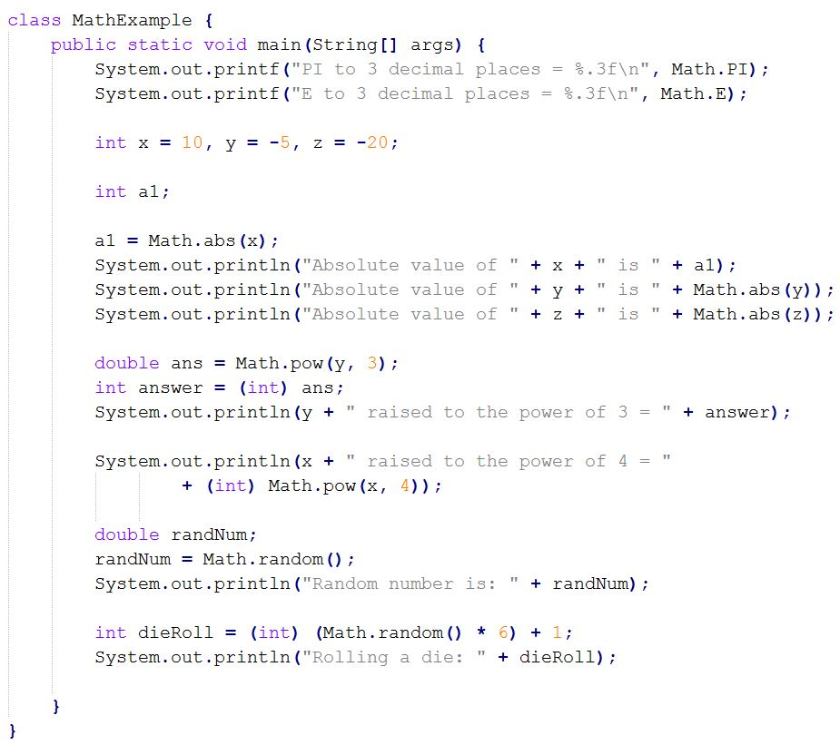

Slide 8
How to use instance fields and methods
Recall that an instance field or method is one that is not declared to be static. Instance is the default
To call upon instance fields or methods in a class library, you have to create one or more objects from that class
A class is a blueprint for building objects.
Syntax for building an object:
className variableName = new className( parameter(s) );
In this format, the first part is the declaration of a reference variable
new is a keyword of the language, and that part of the statement builds a "new" object, and runs a special initialization function called a constructor. This is what the parameters are for
Examples:
Scanner input = new Scanner(System.in);
JButton myButton = new JButton("Click Me");
String s1 = new String();
Once you have declared one or more objects, call upon fields and methods with the dot-operator, as before, but for instance members, use the object's name (i.e. the reference variable) on the left of the dot:
objectName.fieldName // fields
objectName.methodName(arguments) // methods
Example uses:
int x = input.nextInt();
myButton.setText("Stop clicking me!");
System.out.print(s1.toUpperCase());

Slide 9
Example: the java.util.Random library
API: java.util.Random
This library is for generating pseudo-random numbers
How computers do "random" number generation
It's really a "pseudo-random" generator
Start with a "seed" value
The seed is used as the input to an algorithm, which generates a seemingly randomized number
Each "random" value generated becomes the seed for the next one
Start with the same seed, and you'll get the same random numbers!
Creating objects of this type:
Random r1 = new Random(); // uses the system time to create seed
Random r2 = new Random(1234); // uses 1234 as the seed
In the above statements, r1 and r2 refer to objects of type Random -- they both can generate a pseudo-random sequence of values
Sample calls to these objects:
int x = r1.nextInt(); // gets a random integer
int y = r1.nextInt(10); // gets a random integer from 0-9
double z = r1.nextDouble(); // gets a random double in range [0,1)

Slide 10
